Slide 1
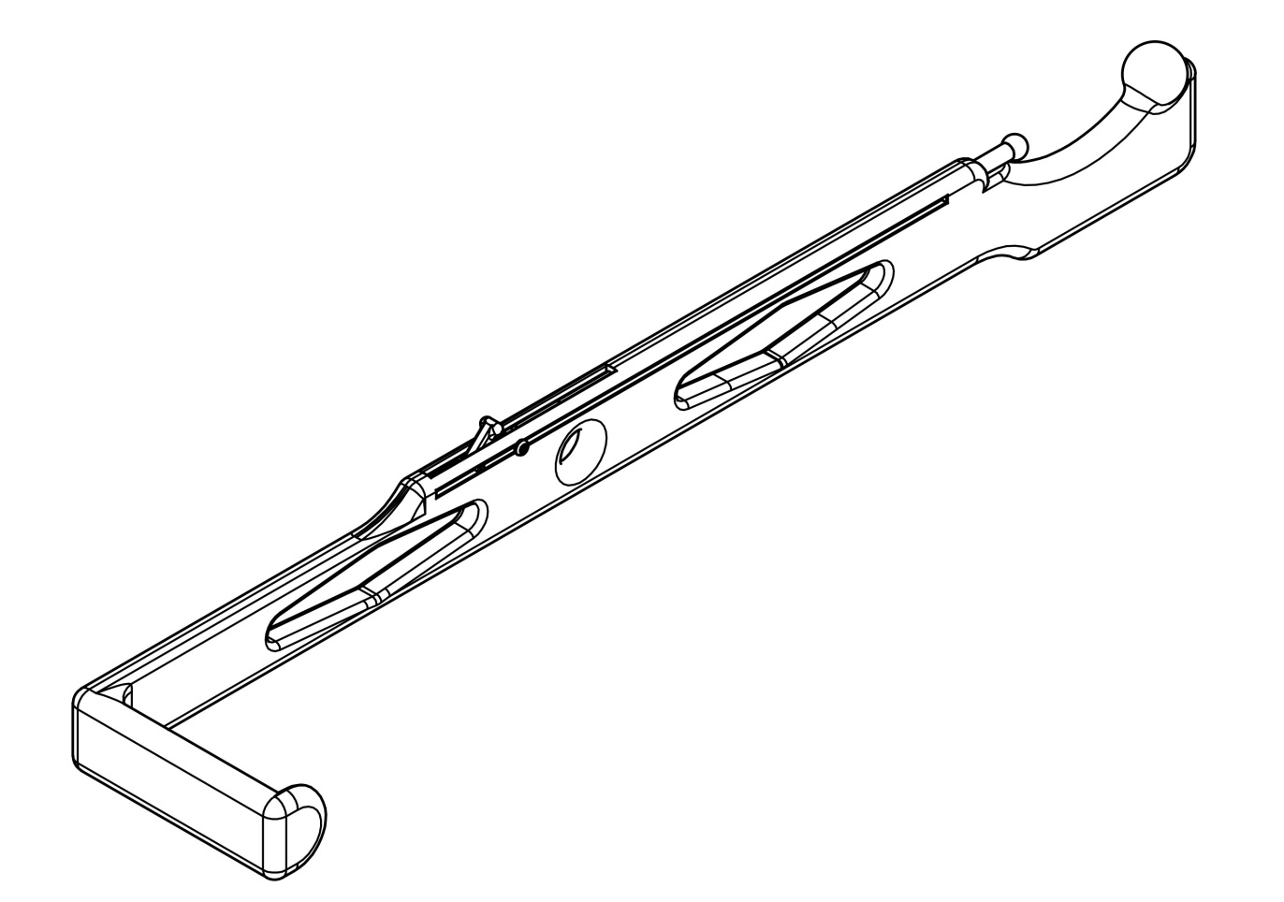
Fallopian Tube Retractor
Alexander Padovano
Alexander Xu
Thomas Prose
Group 18
Notes:
Good morning everyone! My name is Alex Padovano and today I will be presenting the Fallopian Tube Retractor.
The goal of our project was to design an instrument to be used in post-partum, minilaparotomy tubal ligations.

Slide 2
What’s the Problem?
Morbidly Obese Patients
Target farther away
Organs compressed
More invasive procedure required
Increased surgery duration
2-3 cm
10-15 cm
Design Overview Analytic Efforts Design Details Manufacturing/Materials Conclusions
Notes:
During this procedure, the surgeon makes a 1 in incision below the belly button, and then uses an Army/Navy retractor to reach behind the uterus and pull out the fallopian tube.
The difficulty arises when the patient is obese, and the surgeon must reach down through a very thick layer of fat to reach the fallopian tube. This can extend the duration of the operation and increases both cost and the risk of negative outcomes.

Slide 3
Design Specifications
A thin, rigid instrument that can aid in the isolation, visualization, and extraction of the fallopian tubes.
Relatively Inexpensive (to manufacture and sell)
  Army Navy Retractors cost ~$15.00 - $20.00
Rounded edges and shallow curves to avoid internal damage
Ambidextrous
Design Overview Analytic Efforts Design Details Manufacturing/Materials Conclusions
Notes:
There are currently no specialized instruments to address this problem on the market, so our client, an OB/GYN, gave us the task of designing a THIN, RIGID instrument that can aid in the ISOLATION, VISUALIZATION, and EXTRACTION of the fallopian tubes.

Slide 4
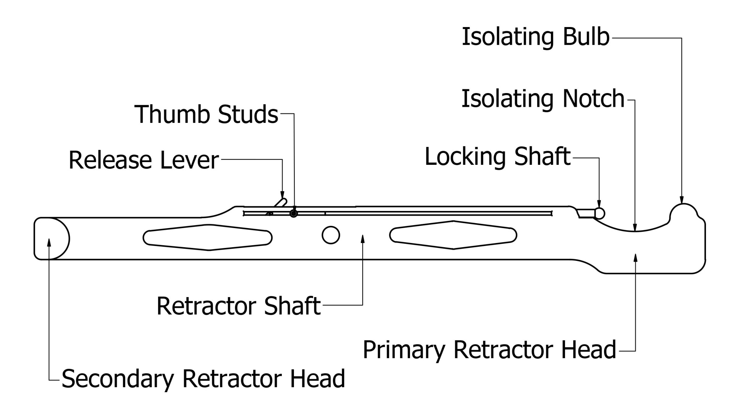
Fallopian Tube Retractor
Design Overview Analytic Efforts Design Details Manufacturing/Materials Conclusions

Slide 5
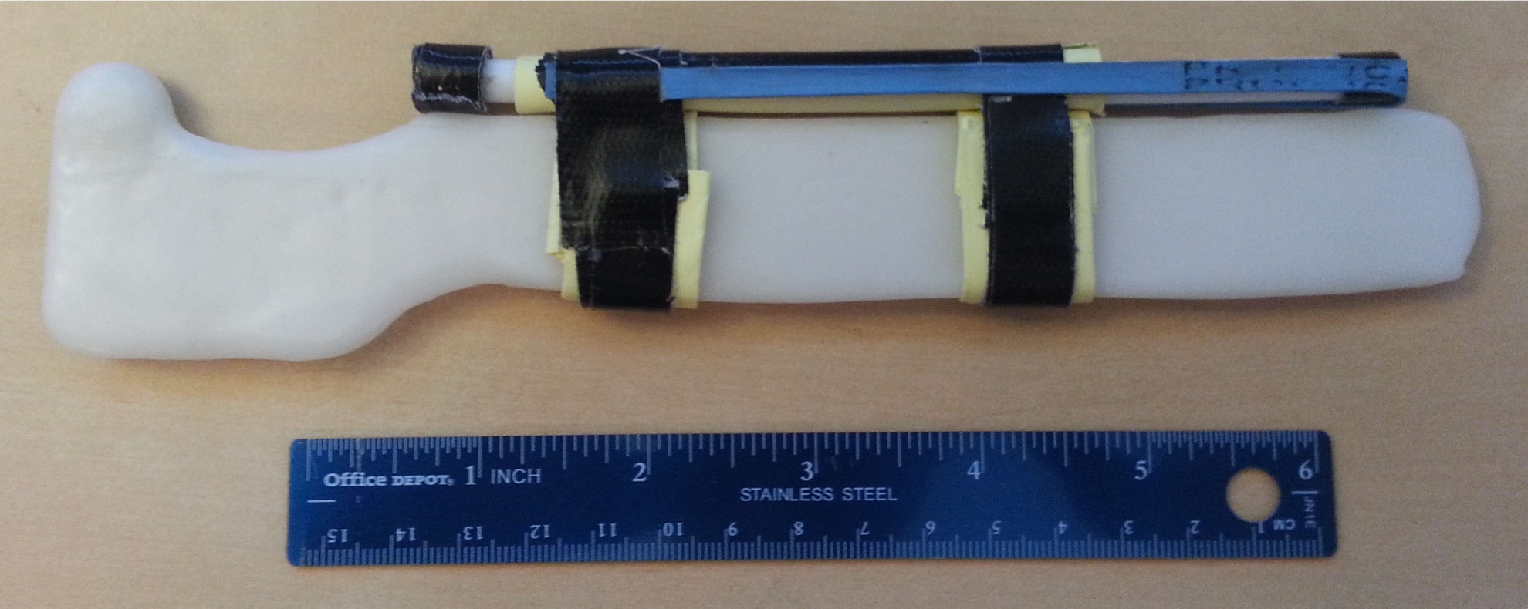
First InstaMorph Prototype
Design Overview Analytic Efforts Design Details Manufacturing/Materials Conclusions
Notes:
We initially planned to have a spring-loaded locking mechanism, and to evaluate this choice, we constructed a rough model.
After our client handled the design, he suggested that we reduce the width an create a more realistic locking mechanism.

Slide 6
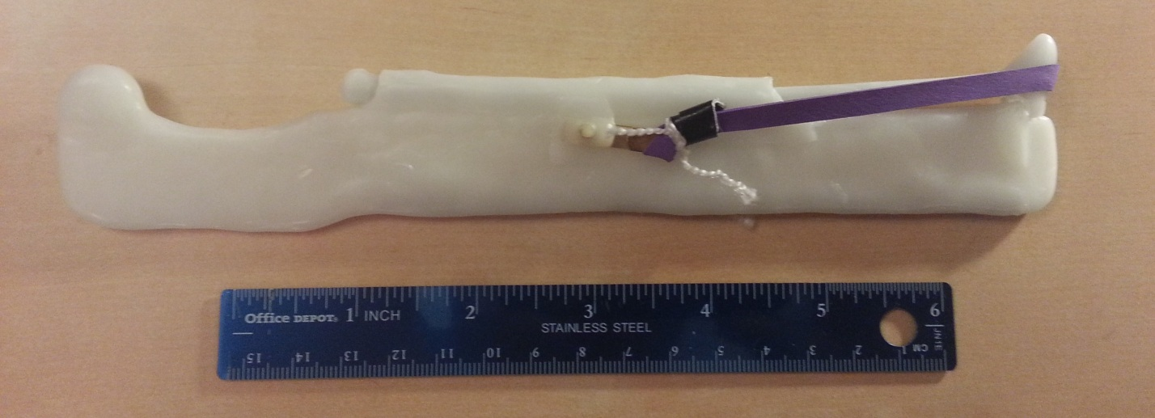
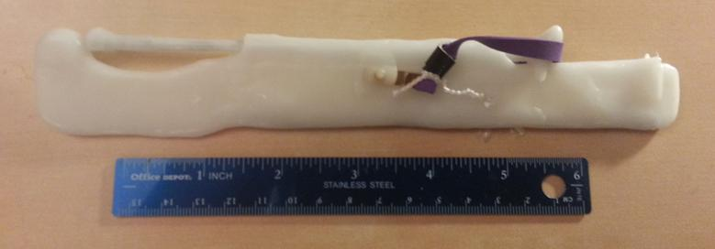
Refined InstaMorph Prototype
Design Overview Analytic Efforts Design Details Manufacturing/Materials Conclusions

Slide 7
Locking Mechanism Pugh Chart
Locking Mechanism | Weight | Spring-Loaded | Manually Sliding | Ratcheted
Cost | 5 | 3 | 6 | 5
Simplicity | 7 | 3 | 6 | 5
Ergonomics | 9 | 8 | 3 | 8
Ease of Use | 9 | 8 | 4 | 8
Safety | 10 | 4 | 9 | 9
Total | n/a | 230 | 223 | 294
Design Overview Analytic Efforts Design Details Manufacturing/Materials Conclusions

Slide 8
Materials Pugh Chart
Material | Weight | SS (316) | Al | SS (304)
Cost | 6 | 5 | 3 | 7
Strength | 7 | 9 | 6 | 8
Sterilization | 6 | 10 | 10 | 10
Manufacturing | 4 | 8 | 8 | 8
Total | n/a | 187 | 158 | 192
Design Overview Analytic Efforts Design Details Manufacturing/Materials Conclusions

Slide 9
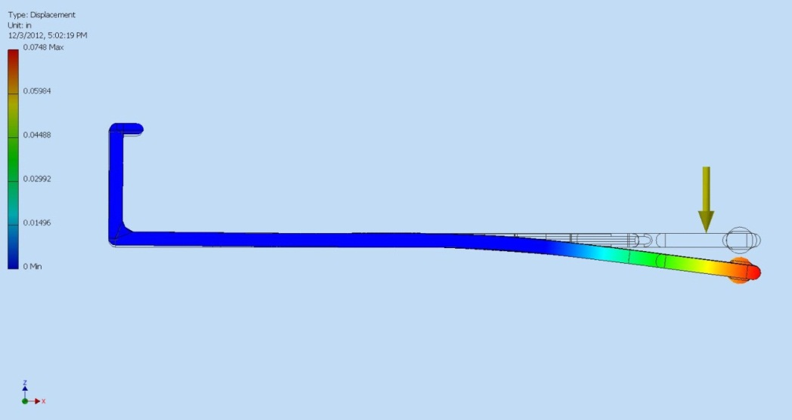
Simulated Stress Tests
Max Displacement = 0.0743 in.
10 kg
Design Overview Analytic Efforts Design Details Manufacturing/Materials Conclusions

Slide 10
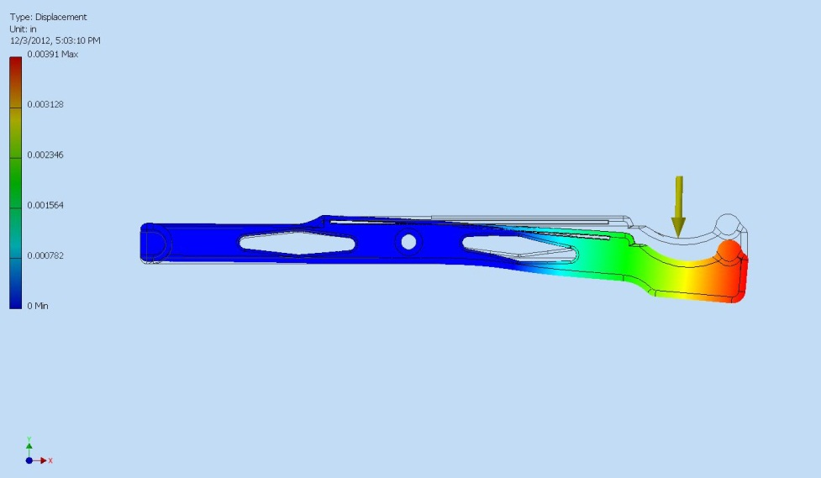
Simulated Stress Tests
Max Displacement = 0.00891 in.
10 kg
Design Overview Analytic Efforts Design Details Manufacturing/Materials Conclusions

Slide 11
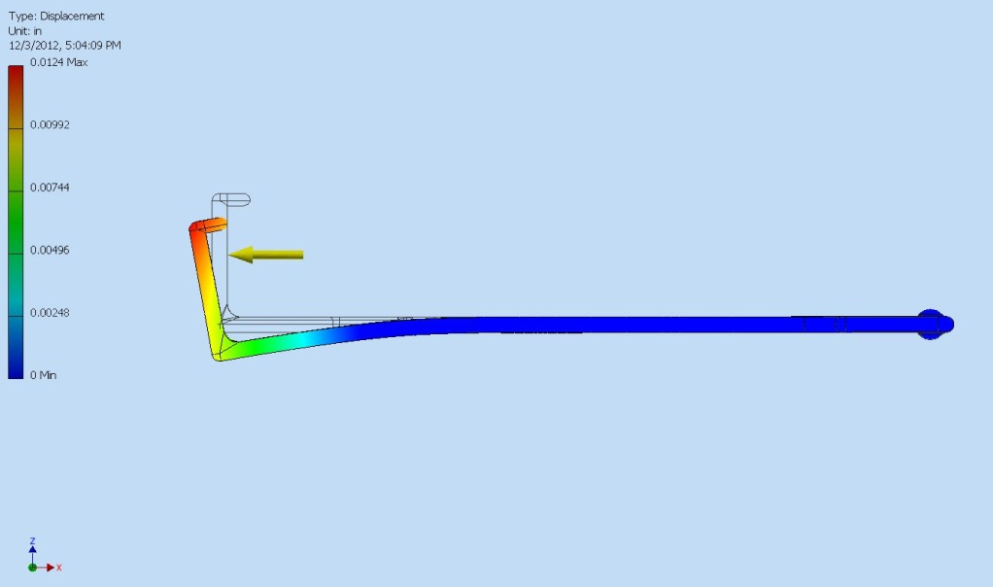
Simulated Stress Tests
Max Displacement = 0.00891 in.
10 kg
Design Overview Analytic Efforts Design Details Manufacturing/Materials Conclusions

Slide 12
Safety: Fallopian Tube Retractor
OPERATORS | TASK/HAZARD PAIRS | RISK LEVEL
 |  | NEGLIGIBLE | LOW
SURGEON (OB/GYN) | 8 | 5 | 3
SURGICAL ASSISTANT | 3 | 3 | 0
NURSES | 2 | 0 | 2
STERILIZATION TECHNICHIAN | 2 | 0 | 2
TOTALS | 15 | 8 | 7
OVERALL RISK: LOW
Design Overview Analytic Efforts Design Details Manufacturing/Materials Conclusions

Slide 13
Safety: Army/Navy Retractor
OPERATORS | TASK/HAZARD PAIRS | RISK LEVEL
 |  | MEDIUM | LOW | NEG.
SURGEON (OB/GYN) | 6 | 2 | 4 | 0
SURGICAL ASSISTANT | 3 | 0 | 0 | 3
NURSES | 2 | 0 | 2 | 0
STERILIZATION TECHNICHIAN | 2 | 0 | 2 | 0
TOTALS | 13 | 2 | 8 | 3
OVERALL RISK: MEDIUM
Design Overview Analytic Efforts Design Details Manufacturing/Materials Conclusions

Slide 14
Design Overview Analytic Efforts Design Details Manufacturing/Materials Conclusions

Slide 15
Design Overview Analytic Efforts Design Details Manufacturing/Materials Conclusions

Slide 16
Design Overview Analytic Efforts Design Details Manufacturing/Materials Conclusions

Slide 17
Design Overview Analytic Efforts Design Details Manufacturing/Materials Conclusions

Slide 18
Design Overview Analytic Efforts Design Details Manufacturing/Materials Conclusions

Slide 19
Design Overview Analytic Efforts Design Details Manufacturing/Materials Conclusions

Slide 20
Design Overview Analytic Efforts Design Details Manufacturing/Materials Conclusions

Slide 21
Design Overview Analytic Efforts Design Details Manufacturing/Materials Conclusions

Slide 22
Design Overview Analytic Efforts Design Details Manufacturing/Materials Conclusions

Slide 23
Manufacturing: Preliminary Prototypes
Preliminary Prototype
  Used for final ergonomic evaluations
  3D-Printed using a rapid-prototyping machine
  Will cost ~$36 to produce
CNC Prototype
  A functioning prototype milled from 304-grade stainless steel
  Used to evaluate the effectiveness of the locking mechanism and during the patent application process.
Design Overview Analytic Efforts Design Details Manufacturing/Materials Conclusions

Slide 24
Manufacturing: Mass Production
All the parts will be press forged, milled, or extruded pieces of 304-grade austenitic stainless steel.
Steel can be purchased from Action Stainless and Alloys
  $1.90/lbs. with a 1 day lead time
  The steel needed for each unit would cost approximately $1.50
Design Overview Analytic Efforts Design Details Manufacturing/Materials Conclusions

Slide 25
Manufacturing: Mass Production
The instruments can be manufactured by Missouri Forge, inc.
  The overhead cost for the forge dies is $60,000
  10,000 units -> total cost of $73,224
  20,000 units -> total cost of $86,448
Design Overview Analytic Efforts Design Details Manufacturing/Materials Conclusions

Slide 26
Conclusions
Did we meet the design scope?
  Yes, we created an effective replacement for Army/Navy retractors in minilaparotomy tubal ligations.
What we learned
  The importance of creating physical prototypes.
Future Directions
  Continued analysis and development through prototyping and testing
  Filing of a Provisional Patent before January 29,2013 to protect the novel retractor and tube-securing mechanism
Design Overview Analytic Efforts Design Details Manufacturing/Materials Conclusions

Slide 27
References
References
1. O’Connell, Dr. Nan. “Postpartum Tubal Sterilization” MedScape Reference: Drugs, Diseases, and Procedures”. Referenced 30 October 2012.
<http://emedicine.medscape.com/article/1848524-overview#a01>
2. “Postpartum Tubal Ligation: Dr. Vincent Padovano.” Fallopian Tube Retractor. Weebly, 30 October 2012.
3. Padovano, V. (2012, September 10). Telephone interview.
4. AK Steel. “Specialty Stainless Sheet & Strip Stainless Price Schedule.” Revised August 2012. See Appendix C1-6.
5. AK Steel. “Product Data Sheet 304/304L Stainless Steel.” See Appendix C7-8.
6. AK Steel. “Product Data Sheet 316/316L Stainless Steel.” See Appendix C9-10.
7. Action Stainless & Alloys, Inc. Phone Quotation. December 3, 2012.
8. Missouri Forge, Inc. Phone Quotation. December 3, 2012.
Design Overview Analytic Efforts Design Details Manufacturing/Materials Conclusions

