Slide 1
Fallopian Tube Isolator Progress
Alexander Padovano
Alexander Xu
Thomas Prose
Group 18

Slide 2
Sterilization Methods
Laparoscopic Procedure: Hysteroscopic Essure Sterilization
4306 women between 2003 & 2010
Tubal Ligation
635,000 procedures annually (8-9% of live births)
325,000 are post-partum minilaparotomy bilateral tubal ligation
Most common method of contraception in women over 35
BACKGROUND PROBLEM PROJECT SCOPE DESIGN ANALYSIS TASKS

Slide 3
Tubal Sterilization Alternatives
Implanon
Placed in skin above upper arm
Up to 3 years of contraception
Affects levels of progestin
Similar to oral contraception
Levonorgestrel Intrauterine Device
Provides effective birth control for 5 years
Relies on local effects of progesterone
Copper Intrauterine Device
Provides effective birth control for 10 years
Inserted and removed through the cervix
Hormone Free
BACKGROUND PROBLEM PROJECT SCOPE DESIGN ANALYSIS TASKS

Slide 4
Post-partum Minilaparotomy Bilateral Tubal Ligation
Permanent sterilization option
Within 48 hours of normal birth
325,000 procedures annually
BACKGROUND PROBLEM PROJECT SCOPE DESIGN ANALYSIS TASKS

Slide 5
Post-partum Minilaparotomy Bilateral Tubal Ligation
3 Common Methods of Occlusion
Modified Pomeroy
Filshie Clip
Parkland
Same Technique for Isolation and Visualization
Ideal situation, use fingers
Generally, use army navy retractor to “fish” for fallopian tubes
Babcock clamp secures the tube
Design Needs to Follow Same Procedure
BACKGROUND PROBLEM PROJECT SCOPE DESIGN ANALYSIS TASKS

Slide 7
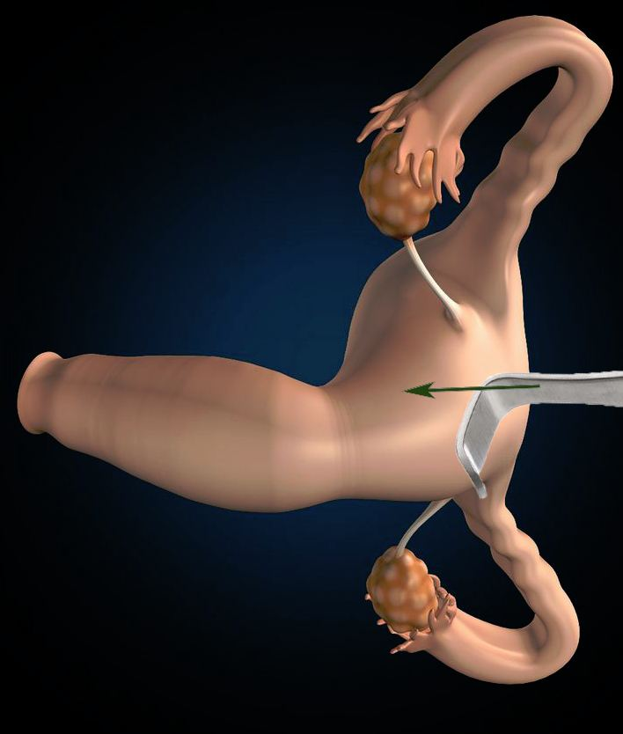

Slide 8
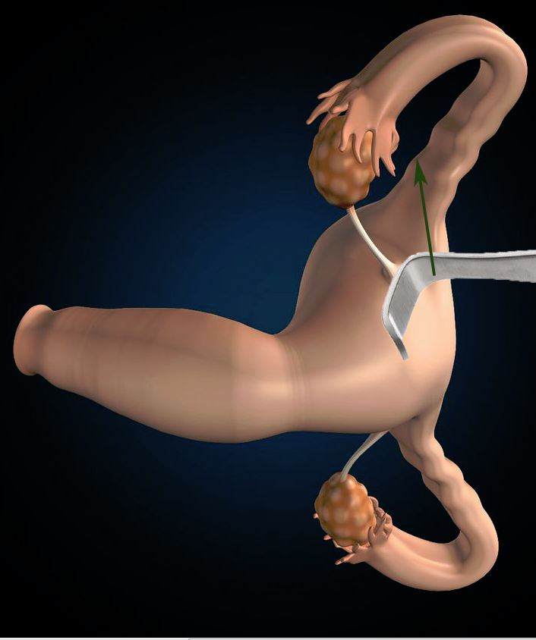

Slide 9
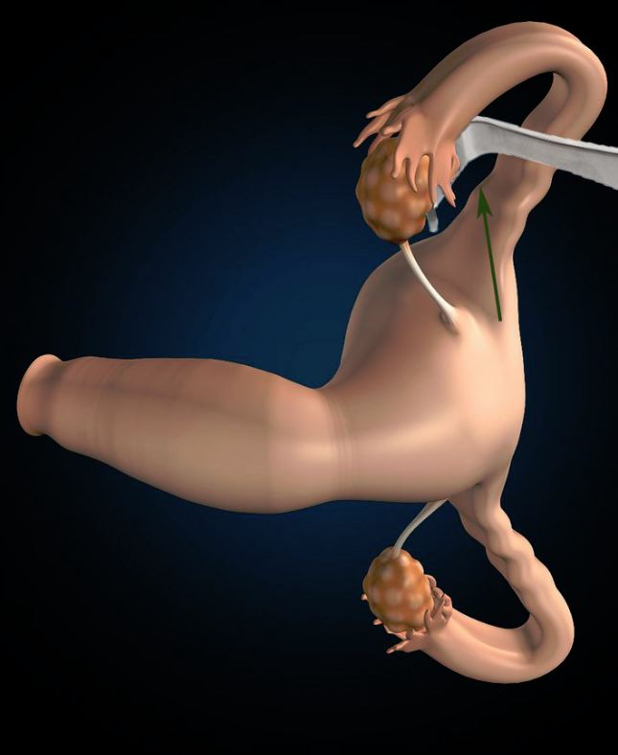

Slide 10
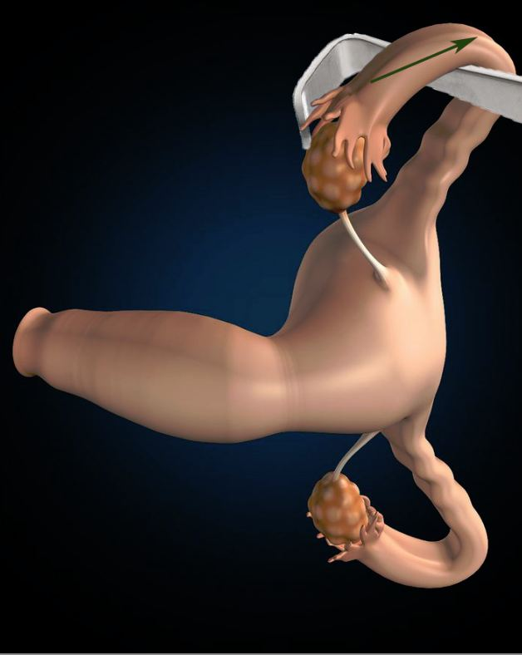

Slide 11
What’s the Problem?
Morbidly Obese Patients
Target farther away
Organs compressed
More invasive procedure required
Increased surgery duration
2-3 cm
10-15 cm
BACKGROUND PROBLEM PROJECT SCOPE DESIGN ANALYSIS TASKS

Slide 12
Project Scope
Task
Design instrument to act as retractor
Purpose
To isolate and secure the fallopian tubes during post-partum minilaparotomy bilateral tubal ligation
Intent
Streamline the procedure
Client: Dr. Vincent Padovano, M.D. OB/GYN
BACKGROUND PROBLEM PROJECT SCOPE DESIGN ANALYSIS TASKS

Slide 13
Design Specifications
12” long
1” wide
Thick enough to remain relatively undeformed under procedural conditions
Relatively Inexpensive (to manufacture and sell)
Army Navy Retractors cost ~$15.00 - $20.00
Groove to isolate fallopian tube
Locking mechanism to secure the fallopian tube
Rounded edges and shallow curves to avoid internal damage
Ambidextrous
BACKGROUND PROBLEM PROJECT SCOPE DESIGN ANALYSIS TASKS

Slide 14
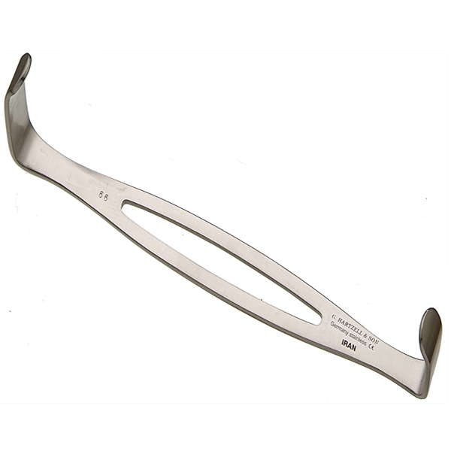
Design Options
Existing solutions
Army navy retractor
CooperSurgical Tubal Retractor
Discontinued
New Design Considerations:
Head to isolate fallopian tube
Locking mechanism to secure tube
Materials
BACKGROUND PROBLEM PROJECT SCOPE DESIGN ANALYSIS TASKS

Slide 15
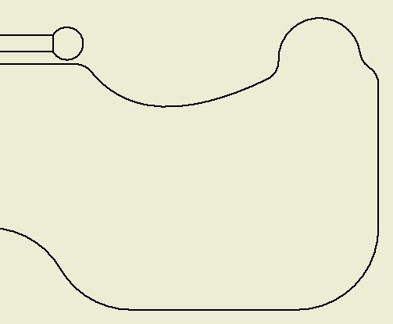
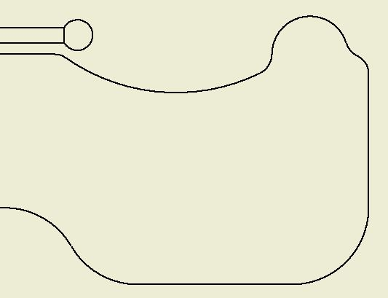
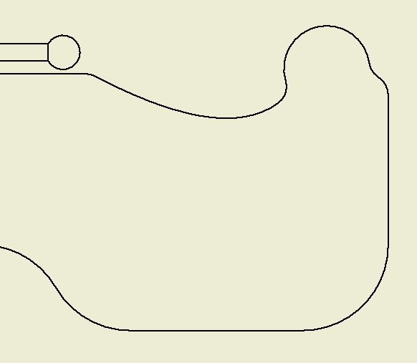
Head Design
Currently no specialized head design for isolating fallopian tube
Three possibilities for notch shape:
Notch 1
Notch 2
Notch 3
BACKGROUND PROBLEM PROJECT SCOPE DESIGN ANALYSIS TASKS

Slide 16
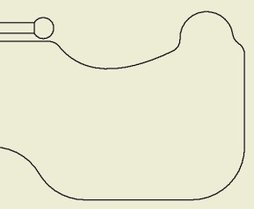
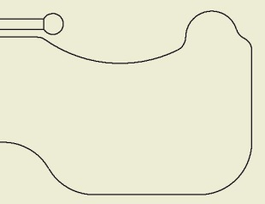
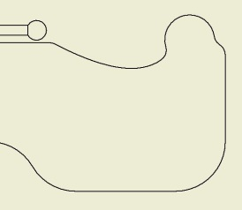
Head Design (Pugh Chart)
Notch 1
Notch 2
Notch 3
Head Design | Weight | Notch 1 | Notch 2 | Notch 3 | Army/Navy
Simplicity | 4 | 4 | 4 | 4 | 10
Hook Effectiveness | 8 | 2 | 6 | 8 | 0
Safety | 10 | 10 | 8 | 6 | 8
Client’s Opinion | 8 | 6 | 8 | 2 | 4
Total | n/a | 172 | 208 | 156 | 152
BACKGROUND PROBLEM PROJECT SCOPE DESIGN ANALYSIS TASKS

Slide 17
Locking Mechanism (Trigger) Design
Currently no existing solutions for such a device
BACKGROUND PROBLEM PROJECT SCOPE DESIGN ANALYSIS TASKS

Slide 18
Locking Mechanism (Trigger) Design Spring Locking Mechanism
BACKGROUND PROBLEM PROJECT SCOPE DESIGN ANALYSIS TASKS

Slide 19
Locking Mechanism (Trigger) Design Passive Sliding Mechanism
BACKGROUND PROBLEM PROJECT SCOPE DESIGN ANALYSIS TASKS

Slide 20
Locking Mechanism (Pugh Chart)
Locking Mechanism | Weight | Spring-Loaded | Passive Slider
Cost | 5 | 4 | 6
Simplicity | 7 | 4 | 6
Ergonomics | 10 | 8 | 4
Ease of Use | 10 | 8 | 4
Safety | 5 | 8 | 9
Total | n/a | 258 | 197
BACKGROUND PROBLEM PROJECT SCOPE DESIGN ANALYSIS TASKS

Slide 21
Materials Analysis
Typical post-partum uterus 1 kg at most
Device at held at ~6” from end, and 1” wide
Allow less than 1% (of length) deflection with 10 * maximum expected weight (10*1 kg = 10 kg)
1% * 6” = 0.06” = 0.0015 m
BACKGROUND PROBLEM PROJECT SCOPE DESIGN ANALYSIS TASKS

Slide 22
Materials Analysis (Continued)
Model shaft as rectangular prism
Deflection: y = WL^3/(3EI), E is Young’s Modulus, I is moment of inertia, W = 10 kg, L = 6” = 0.15 m
Moment of Inertia I = hb^3/12, b & h are cross-sectional dimensions, b = 1” = 0.0254 m
BACKGROUND PROBLEM PROJECT SCOPE DESIGN ANALYSIS TASKS

Slide 23
Materials Analysis (Continued)
“Surgical” Stainless Steel: E = 180 GPa
As low as $1000/metric ton
Thickness needed for 1% deflection:
y = WL^3/(3EI), I = b^3*h/12
h = (4wL^3)/(Eyb^3) = 3*10^-5 m
Aluminum: E = 69 GPa
As low as $2000/metric ton
Thickness needed for 1% deflection:
h = (4wL^3)/(Eyb^3) = 8*10^-5 m
ABS Plastics: E = 2.3 GPa
As low as $100/metric ton
Thickness needed for 1% deflection:
h = (4wL^3)/(Eyb^3) = 2.4*10^-3 m
Ultra High Density Polyethylene: E = 0.69 GPa
As low as $1000/metric ton
Thickness needed for 1% deflection:
h = (4wL^3)/(Eyb^3) = 8*10^-3 m
BACKGROUND PROBLEM PROJECT SCOPE DESIGN ANALYSIS TASKS

Slide 24
Materials (Pugh Chart)
Material | Weight | SS (316) | Al | ABS Plastics | HD Poly.
Cost | 2 | 7 | 5 | 10 | 8
Strength | 8 | 10 | 8 | 4 | 2
Sterilization | 6 | 10 | 10 | 4 | 4
Manufacturing | 4 | 8 | 8 | 6 | 6
Total | n/a | 186 | 166 | 100 | 80
BACKGROUND PROBLEM PROJECT SCOPE DESIGN ANALYSIS TASKS

Slide 25
Final Design
Groove deepest in the middle to balance “hook” effectiveness and safety (avoiding internal damage)
Spring-loaded trigger/locking mechanism for easy release and reload
Stainless steel composition for balanced strength, cost, ease of sterilization, as well as simplicity in manufacturing
BACKGROUND PROBLEM PROJECT SCOPE DESIGN ANALYSIS TASKS

Slide 26
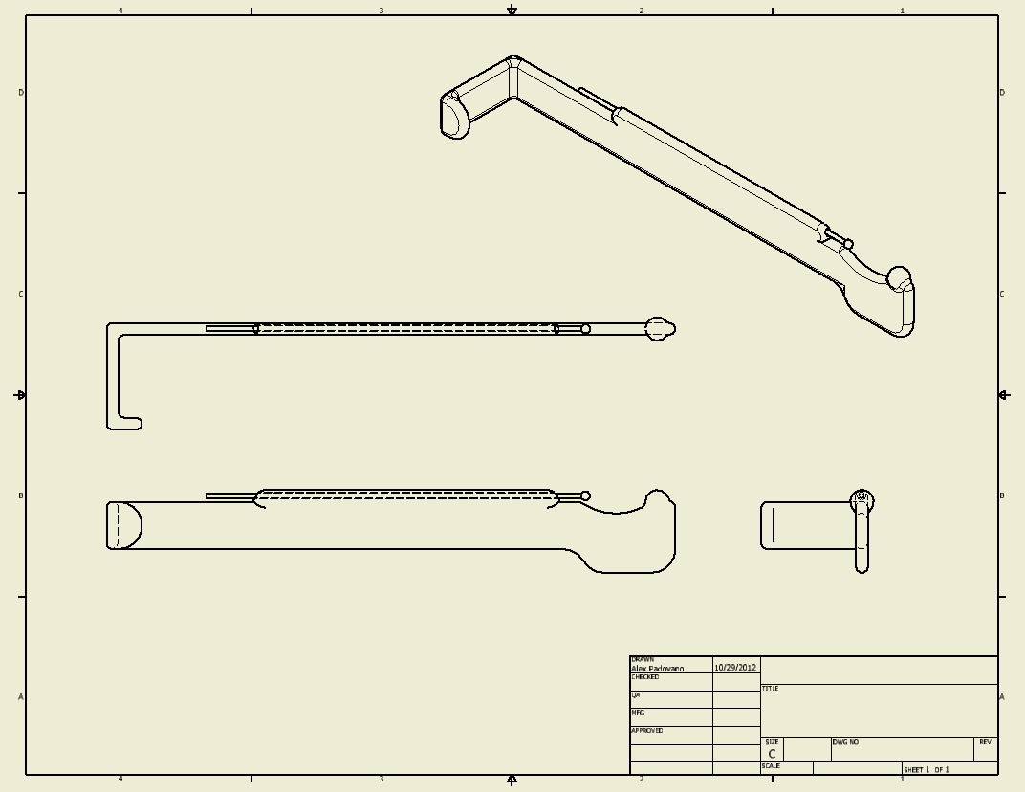
Final Design Summary
Note: Drawing does not include trigger/locking mechanism in drawing
BACKGROUND PROBLEM PROJECT SCOPE DESIGN ANALYSIS TASKS

Slide 27
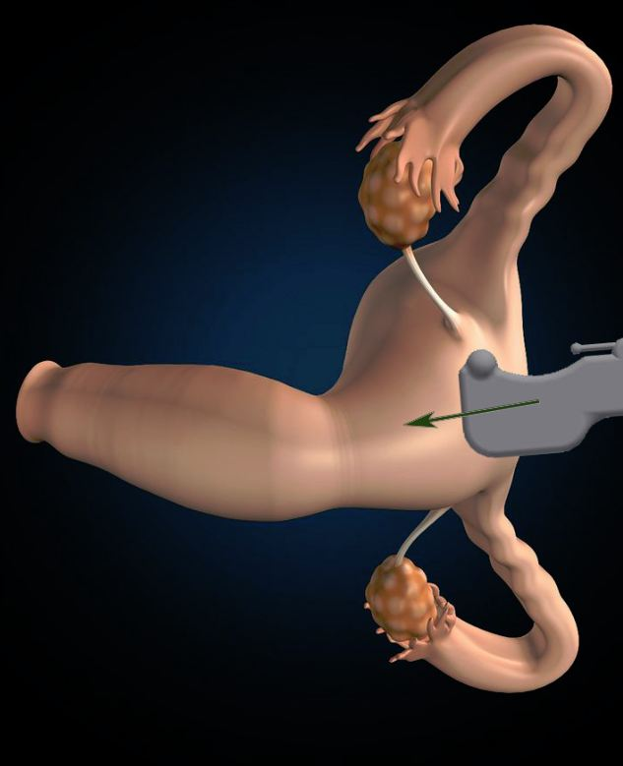

Slide 28
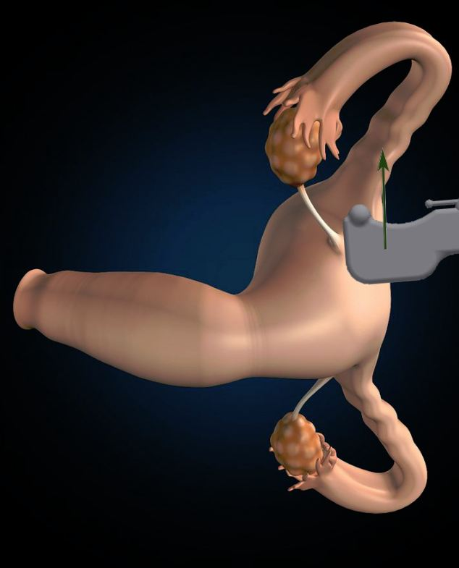

Slide 29
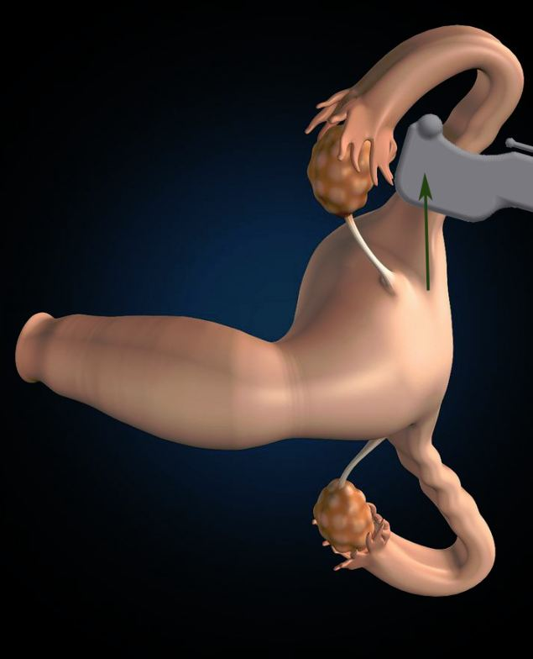

Slide 30
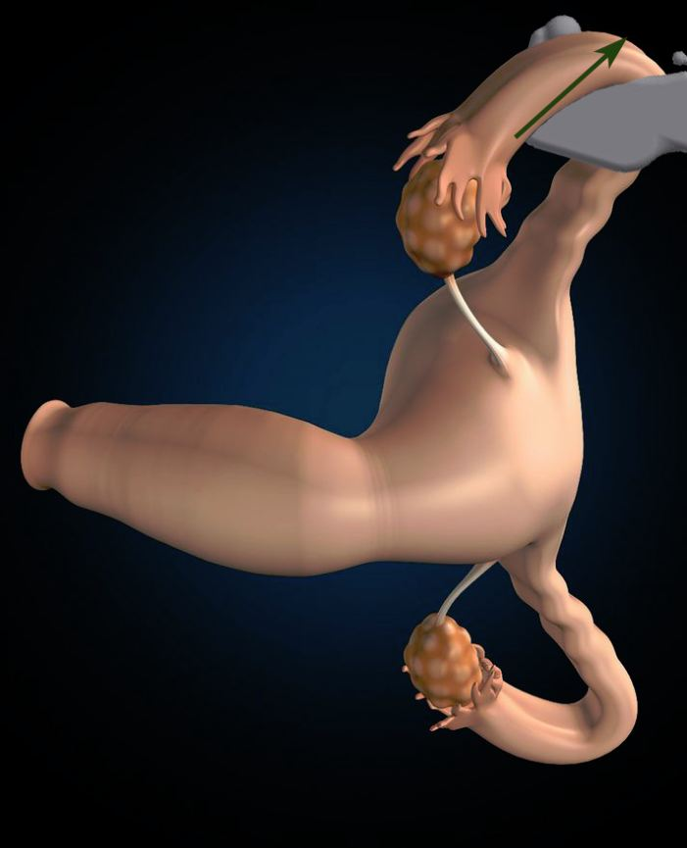

Slide 31
Task Organization
TOM PROSE | ALEX PADOVANO | ALEX XU
BACKGROUND RESEARCH | VISUAL DESIGNER, CLIENT CONTACT | CALCULATIONS, WEBMASTER
PRESENTATION 1 | PRESENTATION 3 | PRESENTATION 2
FIRST PAPER LEAD WRITER | THIRD PAPER LEAD WRITER | SECOND PAPER LEAD WRITER
BACKGROUND PROBLEM PROJECT SCOPE DESIGN ANALYSIS TASKS

Slide 32
Planned Tasks
3D-printed prototypes from CAD models
Ergonomics Testing with Physical Protoypes
Client Feedback
Finalize Design
BACKGROUND PROBLEM PROJECT SCOPE DESIGN ANALYSIS TASKS

Slide 33
Updated Timeline
 | SEPTEMBER |  |  |  | OCTOBER |  |  |  | NOVEMBER |  |  |  |  |  |  |  | DECEMBER
CHOOSE TOPIC
PATENT/LIT SEARCH
FINALIZE LOCKING MECHANISM
SELECTED DESIGN
MATERIALS SEARCH COMPLETE
1st PHYSICAL PROTOYPE (w/ CAD MODELS)
SIMULATED TESTING (ERGONOMICS)
CLIENT FEEDBACK
2nd PHYSICAL PROTOYPE
ERGONOMICS TESTING
CLIENT FEEDBACK
FINAL DESIGN/PHYSICAL MODEL
BACKGROUND PROBLEM PROJECT SCOPE DESIGN ANALYSIS TASKS

Slide 34
References
Post-partum Tubal Sterilization:http://emedicine.medscape.com/article/1848524-overview#a15
Complications of Essure Sterilization:http://www.ncbi.nlm.nih.gov/pubmed/22360159
Tubal Sterilization Treatment and Management: http://emedicine.medscape.com/article/266799-treatment#a1132
Implanon Contraceptive Implant: http://www.mayoclinic.com/health/implanon/MY01007
Intrauterine Devices: http://www.webmd.com/sex/birth-control/intrauterine-device-iud-for-birth-control
Metal prices: http://www.lme.com/home.asp
Materials “Market:” http://www.alibaba.com/showroom/
Plastics: http://www.plastic-products.com/spec11.htm
Young’s moduli: http://www.engineeringtoolbox.com/young-modulus-d_417.html

Slide 35
QUESTIONS?

